Slide 1


Slide 2
INTRODUCTION
Airbnb was founded in August 2008 in San Francisco, California.
It was founded by three roomates Brian Chesky, Joe Gebbia & Nathan Blecharczyk.
The company operates in 81,000 cities and 191 countries with with more than 5 million lodging listing with offices in 20cities all over the world.
The company was started with a initial funding of $20,000 investment by Y Combinator.
The total funding of the company is $4.5Bn where latest funding amount was $1Bn.
The revenue of the company is $3Bn and the market valuation is $31Bn for the year 2017.

Slide 3
WHAT DOES IT DO?
Airbnb is an online marketplace and hospitality service, enabling people to lease or rent short-term lodging including vacation rentals, apartment rentals, homestays, hostel beds or hotel rooms. The Company does not own any lodging
It also provides reservation facility for booking in restaurant
It is merely a broker and receives percentage service fees from both guests and hosts in conjunction with every booking.

Slide 4
REVENUE & COSTS
Commission from Host
Commission from Guest
Real Estate Agencies
Governments
Payment Processing Channels
Lifestyle Media Companies
Development Process
Customer Acquisition
Infrastructure Cost

Slide 5
Function
Offshore Operations
Tour and Travels
Legal
Photography
Administration
Business Development
Customer Service
Finance & Accounts
Product Management

Slide 6
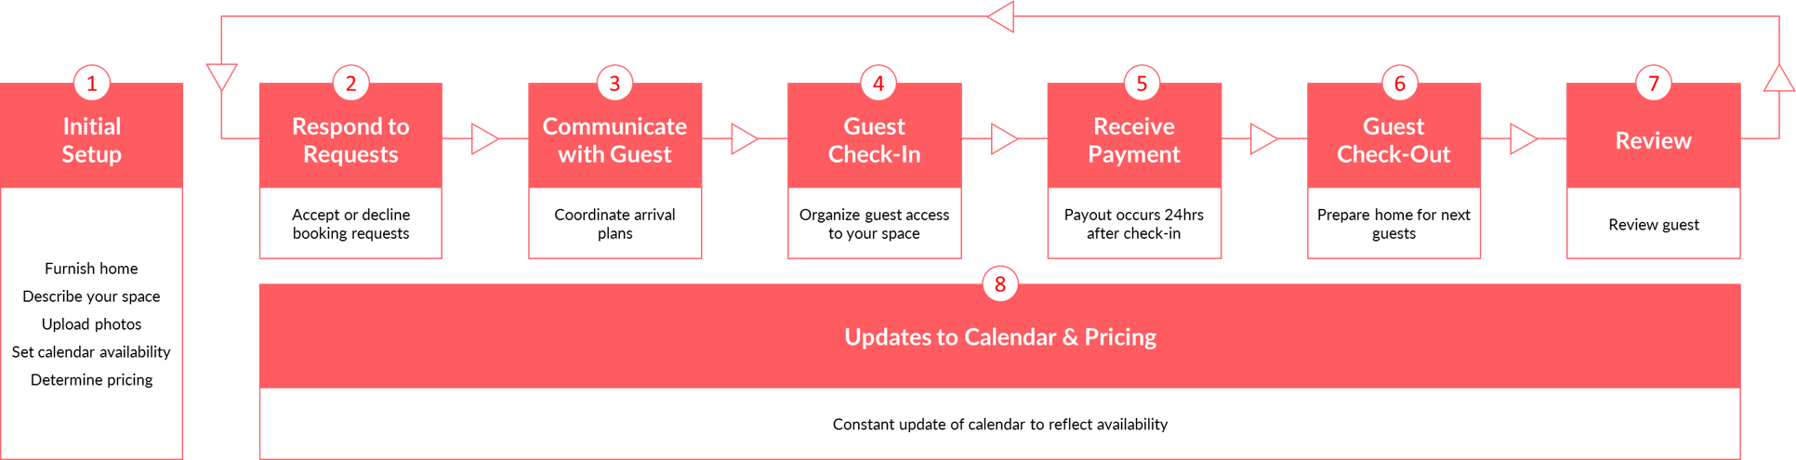
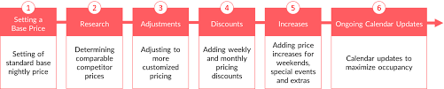
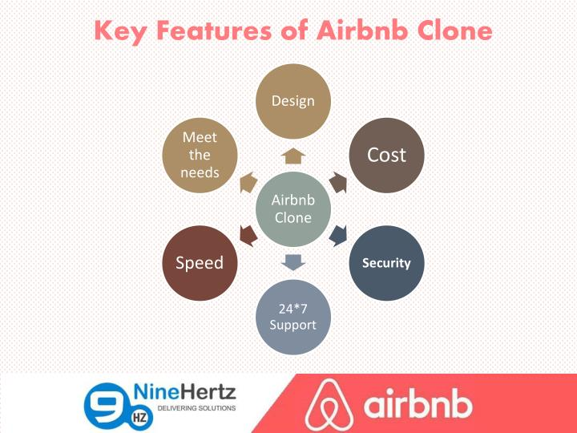

Slide 7
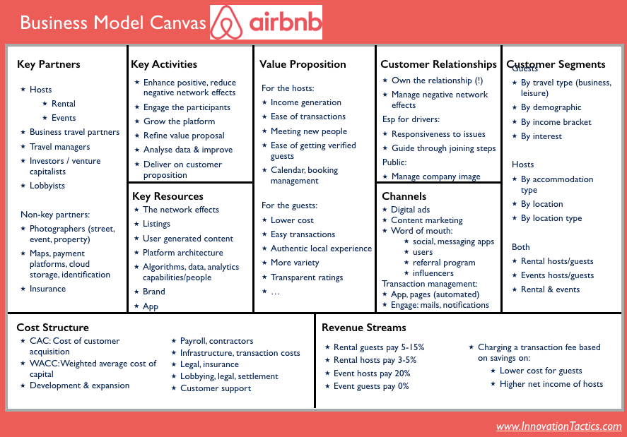

Slide 8
KPI’s and Metric
Guests per night
Total instant bookable listings
Total listings
Monitoring the competitors traffic KPIs.
Average revenue per customer
Usage metrics
Monthly Active Users (MAU)
Bounce rate
Time spent on site

Slide 9
Business metrics
Customer Acquisition Cost (CAC)
Customer Lifetime Value (CLV)
User satisfaction metrics
Transaction metrics
Liquidity
Provider-to-customer ratio (Airbnb’s figure is 1:70, Uber’s is 1:50, and eBay’s is 1:5).
Repeat purchase ratio (Airbnb’s repeat purchase ratio is 22%)

Slide 10
Business metrics
Customer Acquisition Cost (CAC)
Customer Lifetime Value (CLV)
User satisfaction metrics
Quality and Performance Metric
Response rate (number of inquiries responded)
Response time (how long to first response on an inquiry)
Acceptance rate (requests to bookings)
Conversion rate (inquiry to bookings)
Transaction metrics
Liquidity
Provider-to-customer ratio (Airbnb’s figure is 1:70, Uber’s is 1:50, and eBay’s is 1:5).
Repeat purchase ratio (Airbnb’s repeat purchase ratio is 22%)

Slide 11
Analysis Implementation
A/B testing
Image Recognition Analysis
Natural language processing
Predictive Modeling
Regression Analysis
Improving Search Using Data
Machine Learning
Using Data to Determine Host Preferences

